Slide 1
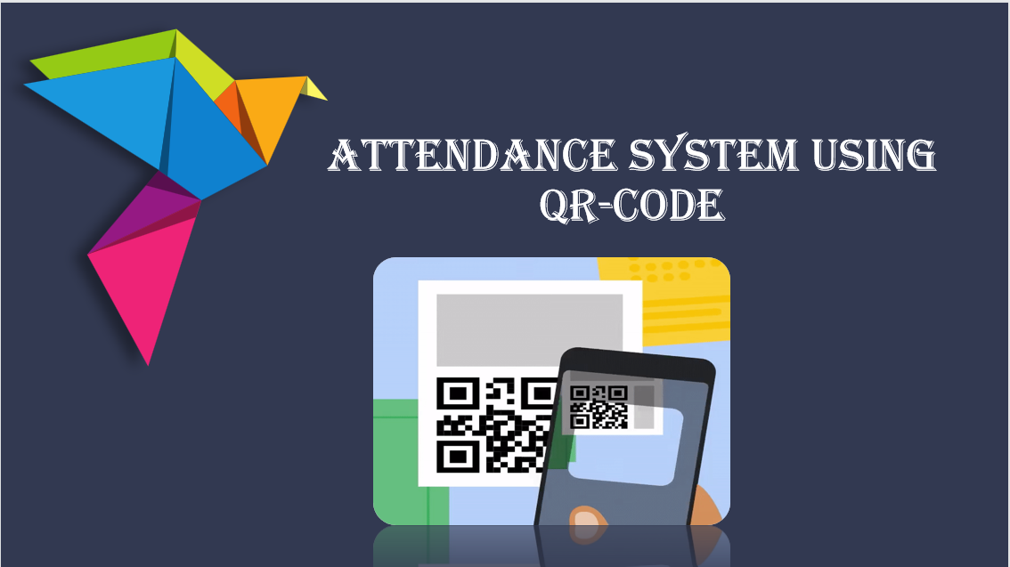

ATTENDANCE SYSTEM USING QR-CODE

Slide 2
PROJECT DESCRIPTION
An Attendance System using QR code is a modern method of recording attendance in an organization.In this system, students or employees are required to scan a QR code using a smartphone or other device with a QR code reader, in order to mark their attendance.
The QR code is generated and displayed on a computer or
projector in the classroom or office, and can be scanned using
the camera on a smartphone or tablet. Once the QR code is
scanned, the attendance is recorded and the system can
confirm the attendance in real-time

Slide 3
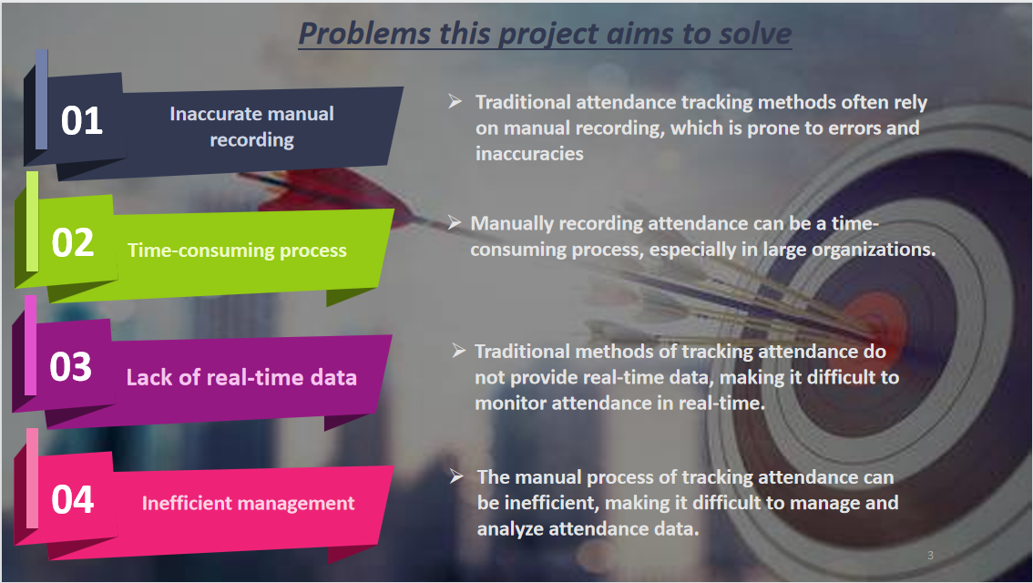

Problems this project aims to solve
01
Inaccurate manual recording
Traditional attendance tracking methods often rely on manual recording, which is prone to errors and inaccuracies
02
Manually recording attendance can be a time-consuming process, especially in large organizations.
Time-consuming process
03
Lack of real-time data
Traditional methods of tracking attendance do not provide real-time data, making it difficult to monitor attendance in real-time.
04
The manual process of tracking attendance can be inefficient, making it difficult to manage and analyze attendance data.
Inefficient management

Slide 4

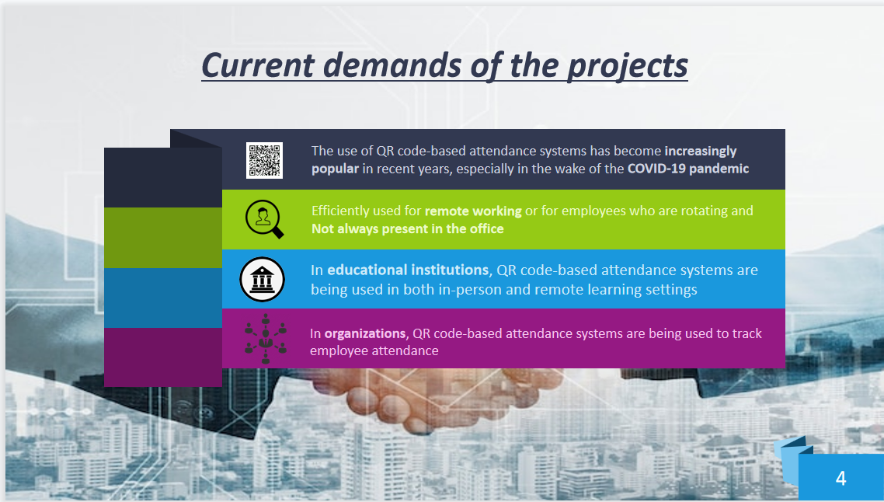
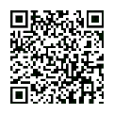



Current demands of the projects
The use of QR code-based attendance systems has become increasingly
popular in recent years, especially in the wake of the COVID-19 pandemic
Efficiently used for remote working or for employees who are rotating and
Not always present in the office
In educational institutions, QR code-based attendance systems are
being used in both in-person and remote learning settings
In organizations, QR code-based attendance systems are being used to track employee attendance
4

Slide 5
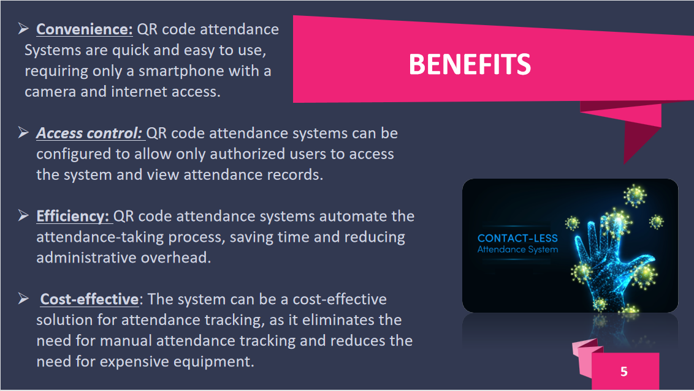

BENEFITS
Convenience: QR code attendance
Systems are quick and easy to use,
requiring only a smartphone with a
camera and internet access.
Access control: QR code attendance systems can be configured to allow only authorized users to access the system and view attendance records.
Efficiency: QR code attendance systems automate the attendance-taking process, saving time and reducing administrative overhead.
Cost-effective: The system can be a cost-effective solution for attendance tracking, as it eliminates the need for manual attendance tracking and reduces the need for expensive equipment.
5

Slide 6
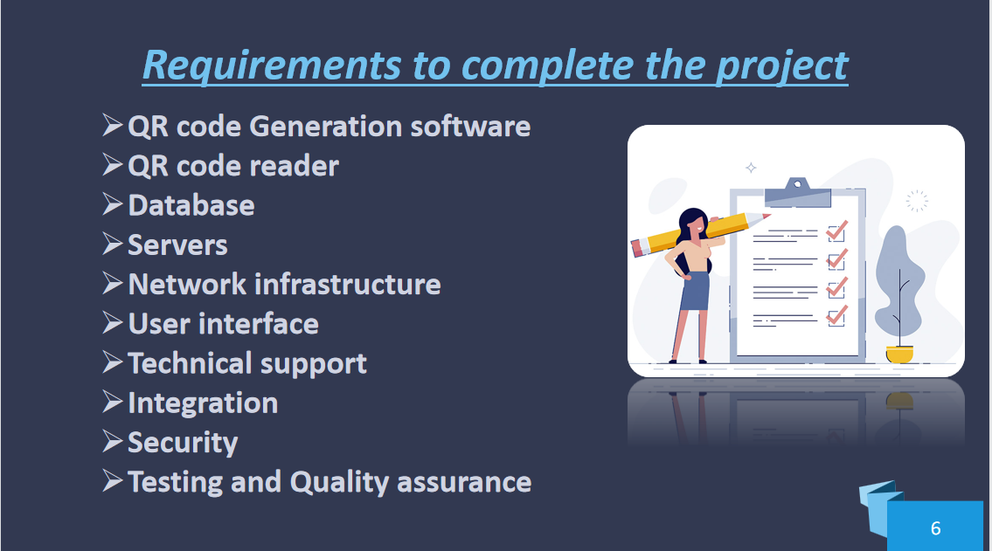

Requirements to complete the project
QR code Generation software
QR code reader
Database
Servers
Network infrastructure
User interface
Technical support
Integration
Security
Testing and Quality assurance

Slide 7
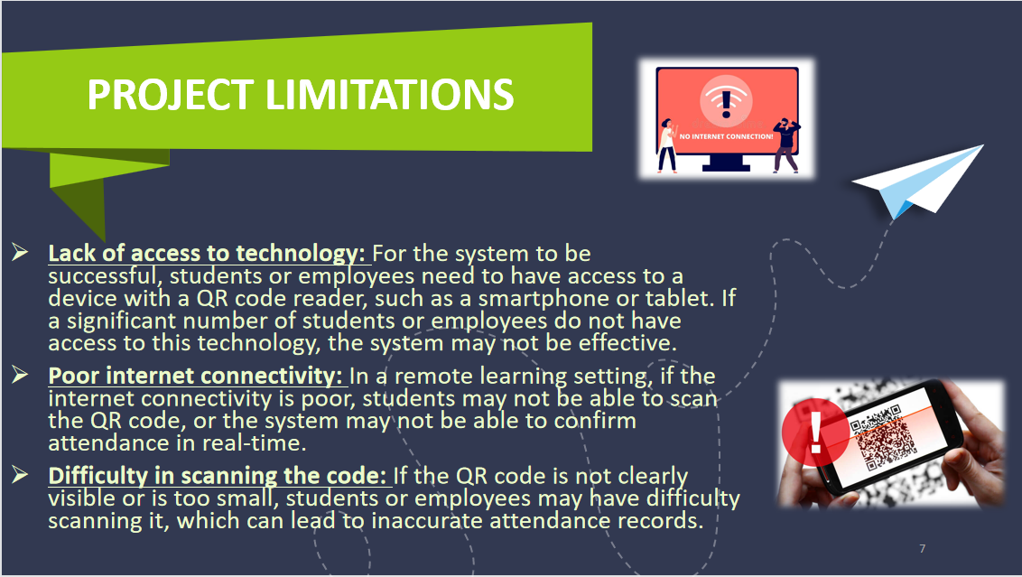

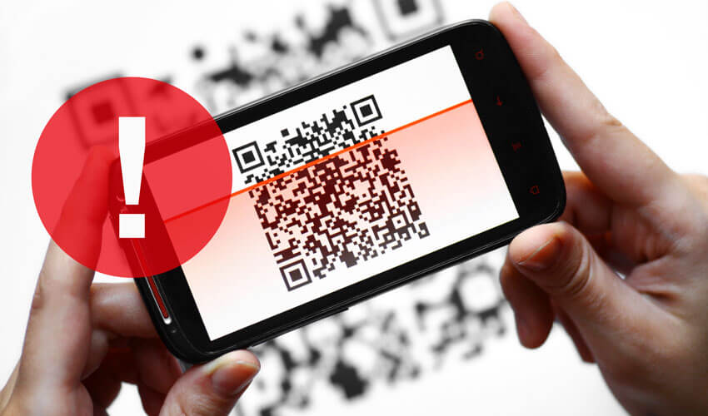
Project Limitations

Slide 8
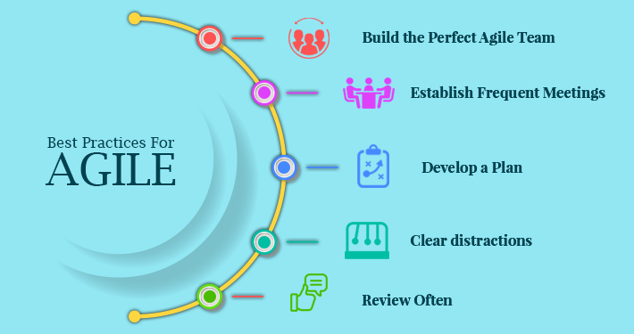

Slide 9

Why We use the agile model
Flexibility: Agile development methodology is flexible, which means that changes can be made easily and quickly during the development process. This is particularly important for an attendance system using QR code because it involves a lot of user interaction and feedback.
Collaboration: Agile involves the collaboration between the development team and stakeholders. An attendance system using QR code needs to be designed with the end-users in mind, and an agile approach enables the development team to work closely with the end-users to ensure that the system meets their needs.
Continuous improvement: An attendance system using QR code is a system that is expected to evolve and improve over time. The agile model is an iterative and incremental approach that emphasizes continuous improvement.
Faster time-to-market: With the agile model, development teams can deliver a minimum viable product (MVP) in a shorter time frame, allowing the system to be deployed quickly and start delivering value to the end-users. This is particularly important for an attendance system using QR code, where users need an efficient and reliable system for attendance tracking as soon as possible.

Slide 10

Comparing agile model with waterfall model
In agile model the performance of the app can be managed depending on the location preference in mean time. In waterfall method it’s not possible.
The customization algorithm which will be used in the system depends on the workload which can be tweaked in Agile based on usage.In waterfall model it’s will hard and take lot of time to modify the existing.
Any person with relevant skill can handle the project with the help of clean documentation in agile.In waterfall model, it’s hard that only people from the beginning can continue because of it’s flexibility.

Slide 11


Slide 12

Who are all the stack holders?
End Users
System Administators
Technical Support
Management
External Vendors

Slide 13
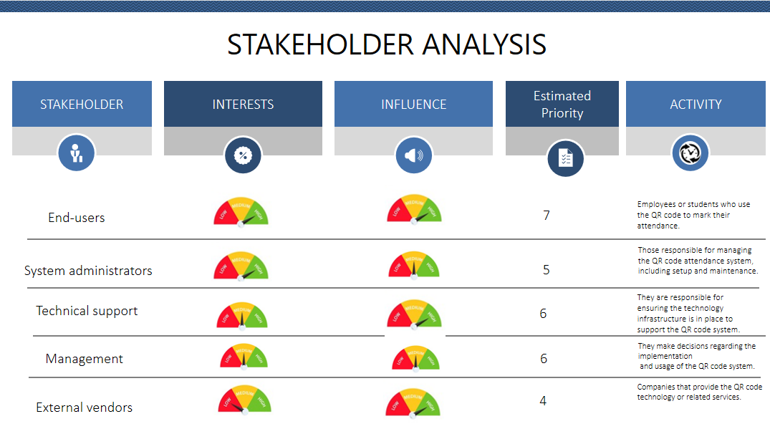

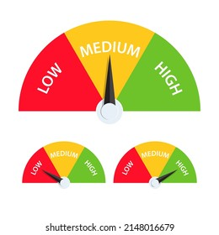
STAKEHOLDER ANALYSIS
STAKEHOLDER
INTERESTS
INFLUENCE
Estimated Priority
ACTIVITY
7
Employees or students who use the QR code to mark their attendance.
End-users
Those responsible for managing the QR code attendance system, including setup and maintenance.
System administrators
5
They are responsible for ensuring the technology infrastructure is in place to support the QR code system.
Technical support
6
Management
6
They make decisions regarding the implementation
and usage of the QR code system.
Companies that provide the QR code
technology or related services.
External vendors
4

Slide 14

Functional Requirements
QR code generation and distribution:
The system should be able to distribute the QR codes to students or attendees in a convenient and secure way, such as through email or a secure online portal
Attendance tracking:
The system should be able to record and store attendance data securely and be able to retrieve it easily
Reporting and analysis:
The system should be able to generate reports that show attendance data, such as who attended and when they attended
Administration:
The system should be able to allow for the management of student or attendee information, such as adding or removing students/attendees, updating contact information, or managing attendance exceptions
Integration and compatibility:
The system should be compatible with a variety of devices and platforms, such as iOS and Android mobile devices, web browsers, or desktop computers

Slide 15

Non-Functional Requirements
Performance:The system should be able to handle a high volume of attendance scans without significant delays or performance issues and to generate attendance reports quickly and accurately
Security:The system should provide secure access to attendance data, ensuring that only authorized users can view or modify attendance records
Usability:The system should be easy to use and navigate for both instructors and students/attendees.The system should have a user-friendly interface and provide clear instructions for QR code scanning and attendance tracking
Compatibility:The system should be compatible with a variety of devices and platforms, such as iOS and Android mobile devices, web browsers, or desktop computers
Scalability:The system should be able to scale up or down as needed to accommodate changes in the number of students/attendees or classes/courses/events.The system should be able to handle increases in attendance data volume without significant performance or usability issues

Slide 16

System requirements
Software requiements
Android Studio
Android OS 4.2+ (Mobile)
MS Excel
Hardware requirement
Android Smartphone running Android OS version 4.0.3(API level 15)+
Input/output
Input: QR code or Bar code
Output: XLS and CSV sheet

Slide 17
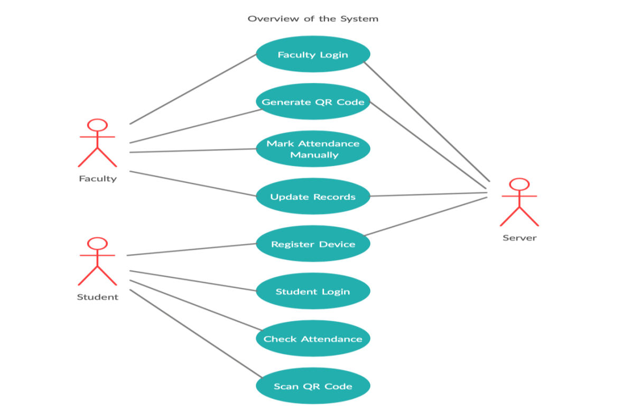
Use case diagram

Slide 18




INTEGRATION MANAGEMENT

Slide 19
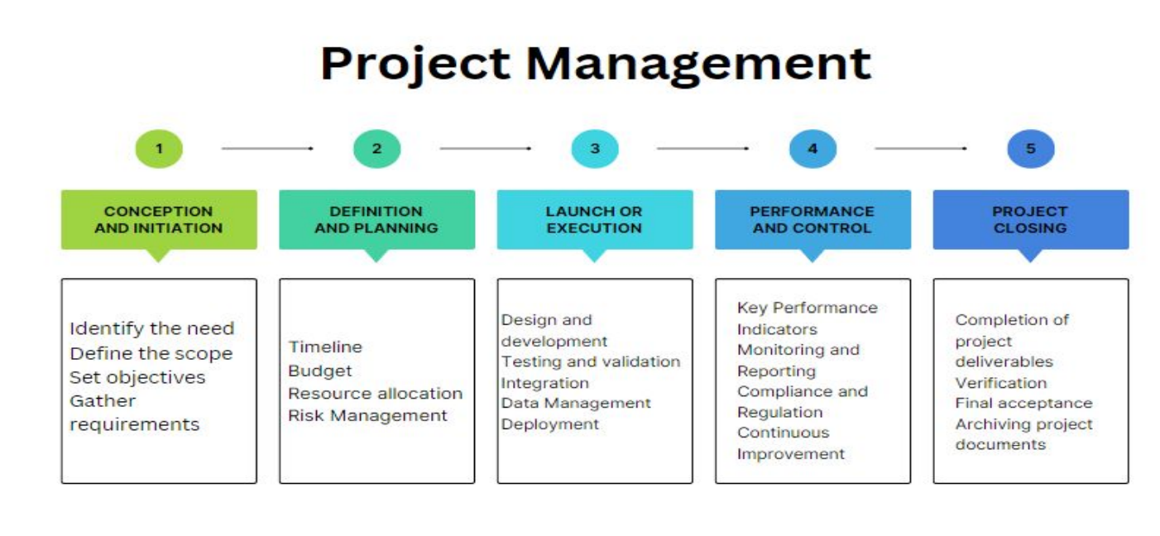
Governance Framework

Slide 20
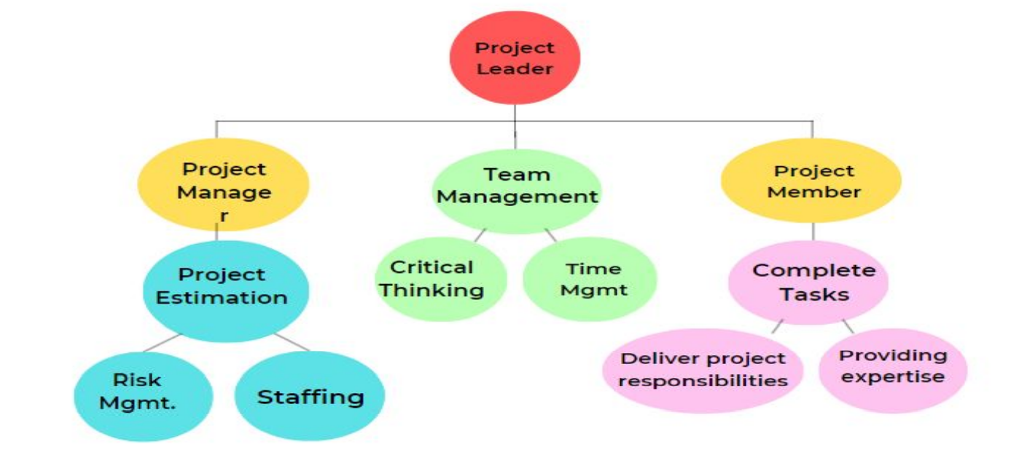
Team Members Roles And Responsibilities

Slide 21


Change management
Change management in project management is the management of a change in resources, process, and people involved in a project. A simple example of change management within project management is if a team had 12 months to finish a project, but a month in, the timeline was cut down to eight months.

Slide 22
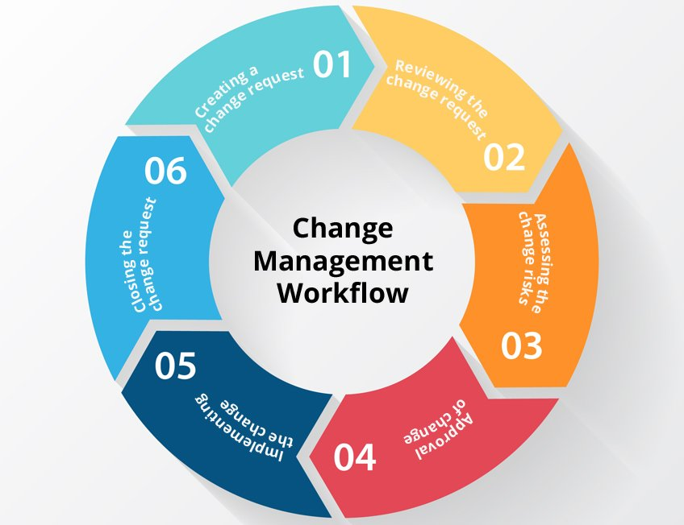
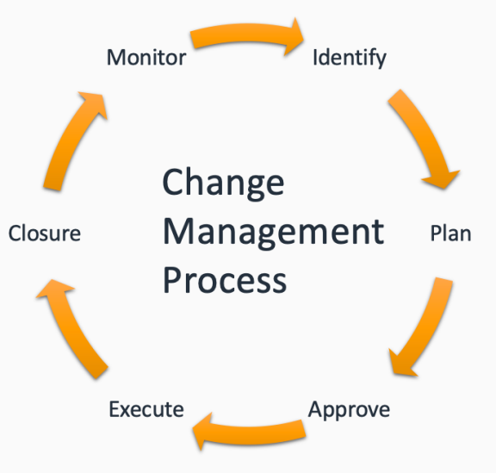
Change management
1
Change Request
2
Reviewing the Request
3
New Plan
4
Plan and change Approval
5
change implementation
6
Change Closure

Slide 23

Schedule management

Slide 24
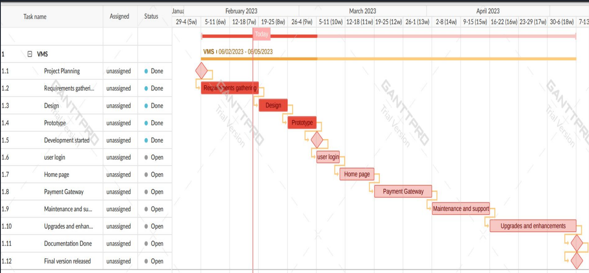

Defining milestones

Slide 25

Schedule control
Step1
Activity Definition
Step2
Activity Sequencing
Step3
Activity Duration Estimation
Step4
Schedule Development
Step5
Schedule Control

Slide 26


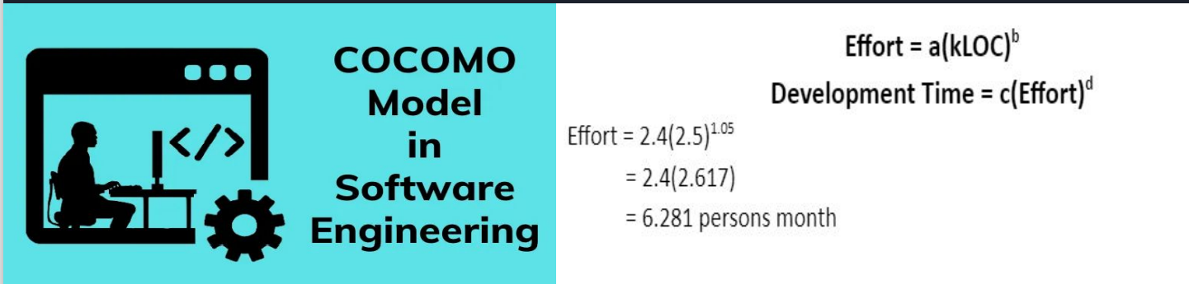

Cost management
Estimate Effort
Boehm proposed COCOMO (Constructive Cost Estimation Model) in 1981. COCOMO is one of the most widely used software estimation models in the world. COCOMO predicts the efforts and schedule of a software product based on the size of the software.

Slide 27
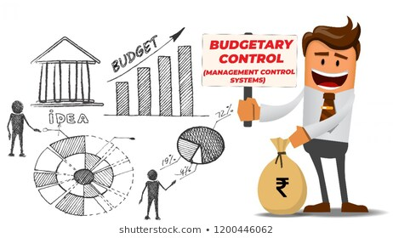
Budget Control
1
Monitor spending
2
Use cost-saving measures
3
Manage project scope
4
Optimize resource utilization
5
Use project management software
6
Regularly review and adjust the budget

Slide 28
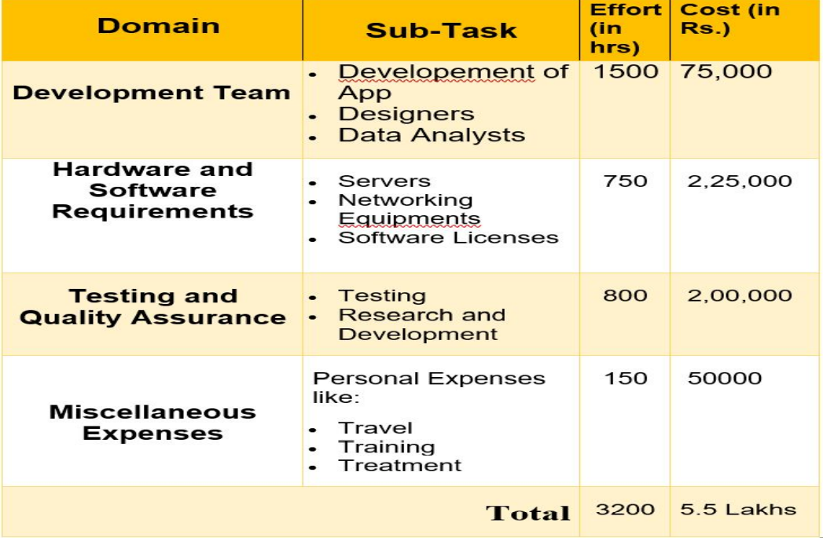
Cost Estimation

Slide 29

Resource management

Slide 30

People and risk
1
Knowledge of vehicle maintenance processes
2
Programming skills
3
Collaboration and communication
4
Project Manager
5
Technical writers
6
Quality Assurance Testers

Slide 31





Facility required
1
2
3
4
5
Development Environment
Database management system
Testing environment
Security Measures
Technical support

Slide 32
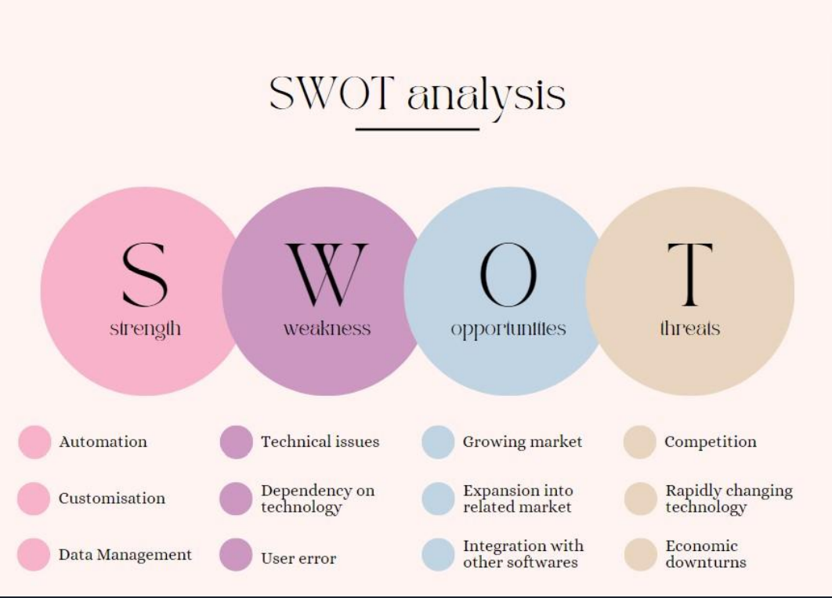
Risk Management

Slide 33
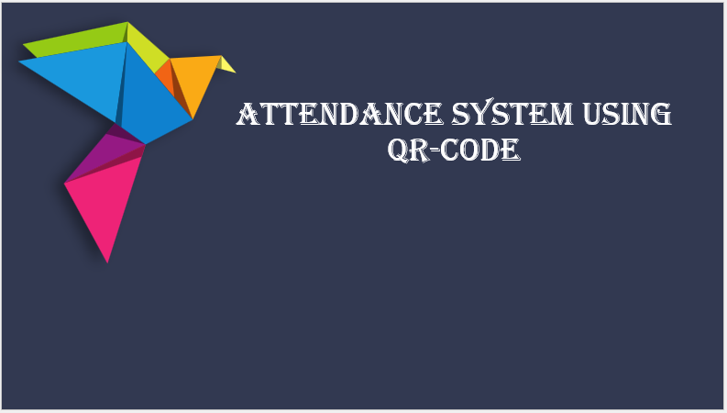
Work breakdown structure,
Timeline chart,
Risk identification table

Slide 34

Work Breakdown Structure
Planning Phase
1.1 Define project scope and requirements
1.2 Conduct feasibility analysis
1.3 Identify project deliverables
1.4 Develop project schedule
1.5 Determine project budget
Analysis and Design Phase
2.1 Analyze user needs
2.2 Define system architecture
2.3 Design database schema
2.4 Create wireframes and mockups
2.5 Select technologies and tools

Slide 35

Development Phase
3.1 Set up development environment
3.2 Develop server-side application
3.3 Develop client-side application
3.4 Integrate QR-code scanning functionality
3.5 Implement database connectivity
3.6 Implement user authentication and authorization
Testing Phase
4.1 Conduct unit testing
4.2 Conduct integration testing
4.3 Conduct system testing
4.4 Conduct user acceptance testing

Slide 36

Deployment Phase
5.1 Deploy system to production environment
5.2 Provide user training and support
5.3 Conduct post-deployment testing
5.4 Monitor system performance and user feedback
5.5 Address any issues or bugs that arise
Maintenance and Upgrades Phase
6.1 Provide ongoing system maintenance
6.2 Implement updates and upgrades as needed
6.3 Address any security vulnerabilities that arise
6.4 Provide technical support to users

Slide 37
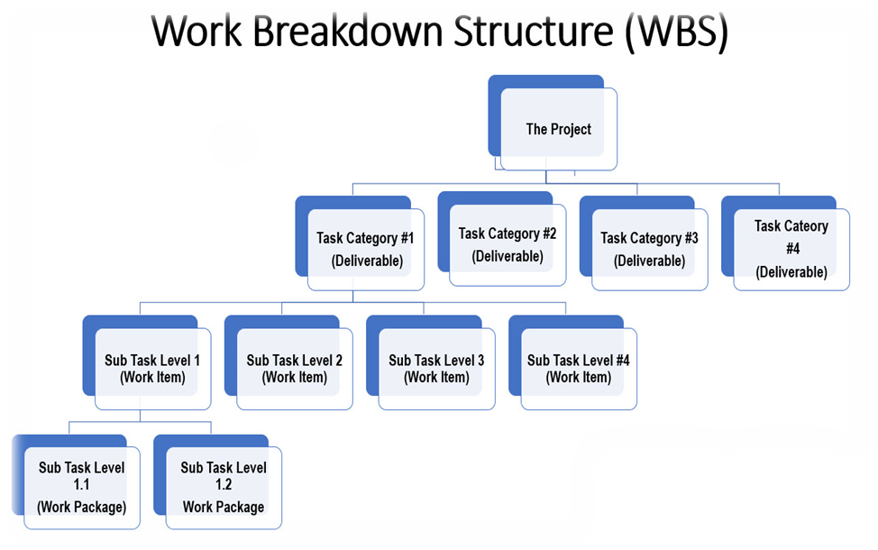

Slide 38

I. Project Planning
Define project scope and objectives
Identify stakeholders
Establish project timeline
Develop project budget
Assign project roles and responsibilities
II. Requirements Gathering
Define functional requirements
Define non-functional requirements
Define user requirements
Define system requirements

Slide 39

III. Design and Development
Design database schema
Develop user interface
Develop backend logic
Develop reporting system
IV. Testing and Deployment
Conduct unit testing
Conduct integration testing
Conduct system testing
Conduct user acceptance testing
Deploy the system

Slide 40

V. Maintenance and Support
Provide ongoing technical support
Perform system maintenance and updates
Monitor system performance and address issues as they arise

Slide 41

Timeline Chart
Timeline charts are highly versatile visual charts that are used to illustrate a set of events chronologically. They're an excellent tool for conceptualizing event sequences or processes to gain insights into the nuances of a project. That could include summarizing historical events, or any other time frame where you need to measure minutes, hours, dates, or years. A timeline is a chart that depicts how a set of resources are used over time.
If you're managing a software project and want to illustrate who is doing what and when, or if you're organizing a conference and need to schedule meeting rooms, a timeline is often a reasonable visualization choice. One popular type of timeline is the Gantt chart.

Slide 42
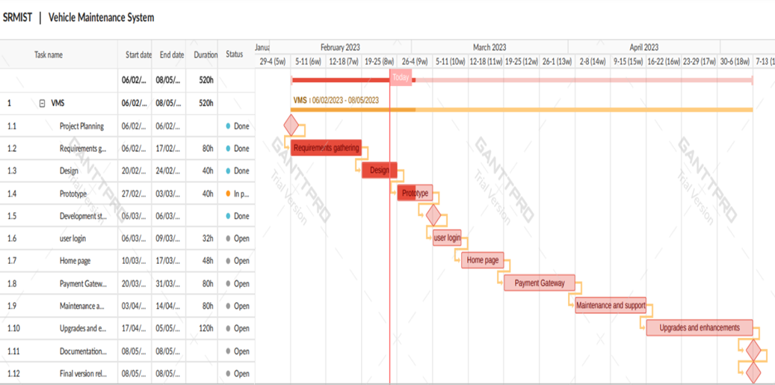

Slide 43

Risk Management
SWOT ANALYSIS:
A SWOT analysis is a useful tool for assessing the strengths, weaknesses, opportunities, and threats of a business or product. Here is a SWOT analysis of a QR code-based attendance system.
Strengths:
Easy to use and convenient for both employees and administrators
Accurate tracking of attendance data and reduction of errors
Can be integrated with other software, such as payroll or time tracking systems
Can save time and reduce paperwork compared to traditional attendance systems

Slide 44

Weaknesses:
Requires access to a smartphone or other device with a QR code scanner
May not be suitable for all industries or work environments
Relies on employees to remember to scan the QR code, which can lead to incomplete data
Opportunities:
Can be used for contactless attendance tracking, which is particularly important during the COVID-19 pandemic
Can provide valuable data for HR and management, such as attendance trends and employee punctuality
Can be used for other purposes, such as tracking equipment or inventory

Slide 45

Threats:
Competing attendance systems may offer similar or better features
Security risks associated with QR codes, such as malicious codes or phishing attacks, may cause concerns for some users
May not be accepted or adopted by all employees or organizations.
Overall, a QR code-based attendance system has several strengths, but also some weaknesses and potential threats. However, the opportunities for improving attendance tracking, collecting valuable data, and enhancing workplace efficiency make it a promising tool for many organizations.

Slide 46
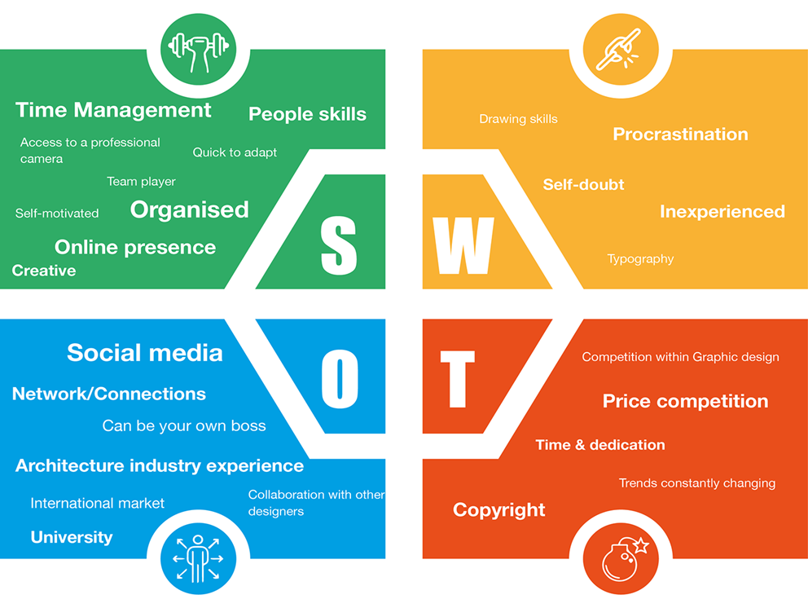

Slide 47

System Architecture, Use case and Class Diagram

Slide 48
Client-side: A mobile application that generates a unique QR code for each attendee and scans the QR code when the attendee arrives. Server-side: A web application that receives the attendance data from the mobile application and processes it. The web application can be built using a web framework such as Django, Flask, or Ruby on Rails.
SYSTEM ARCHITECTURE

Slide 49
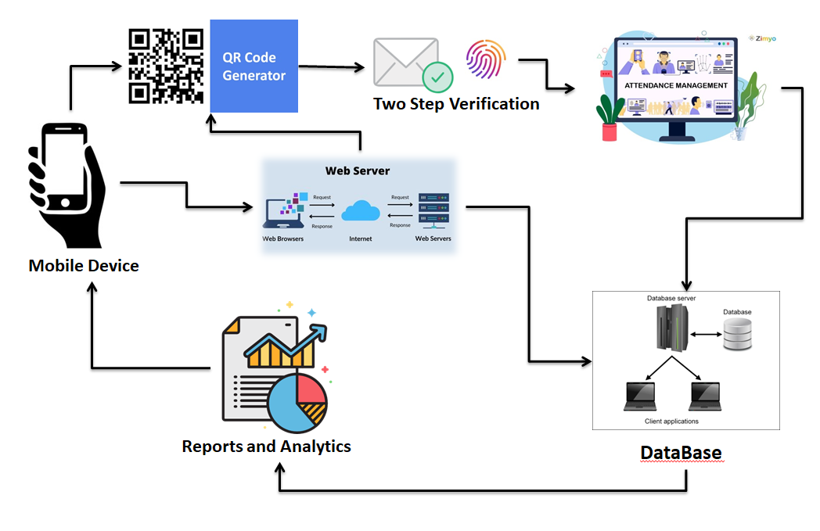
System Architecture

Slide 50
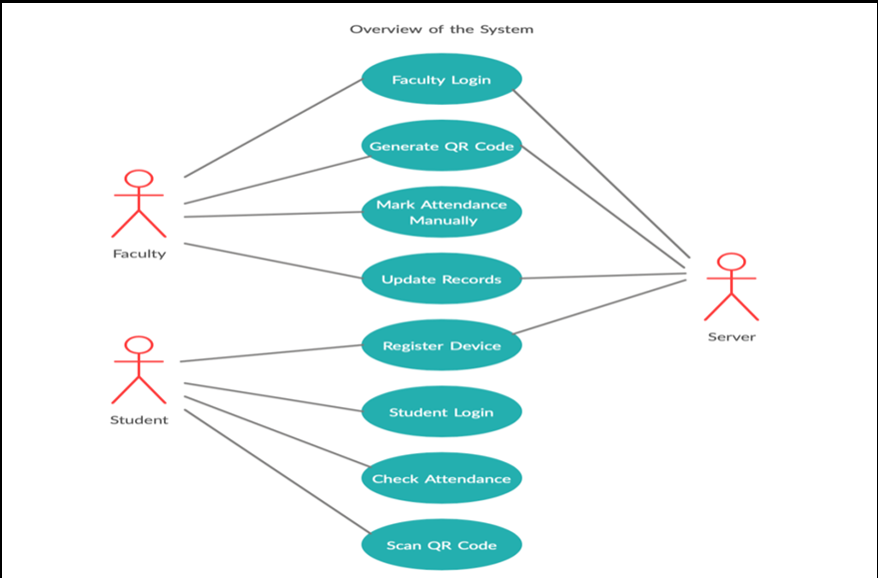
USE CASE DIAGRAM:

Slide 51
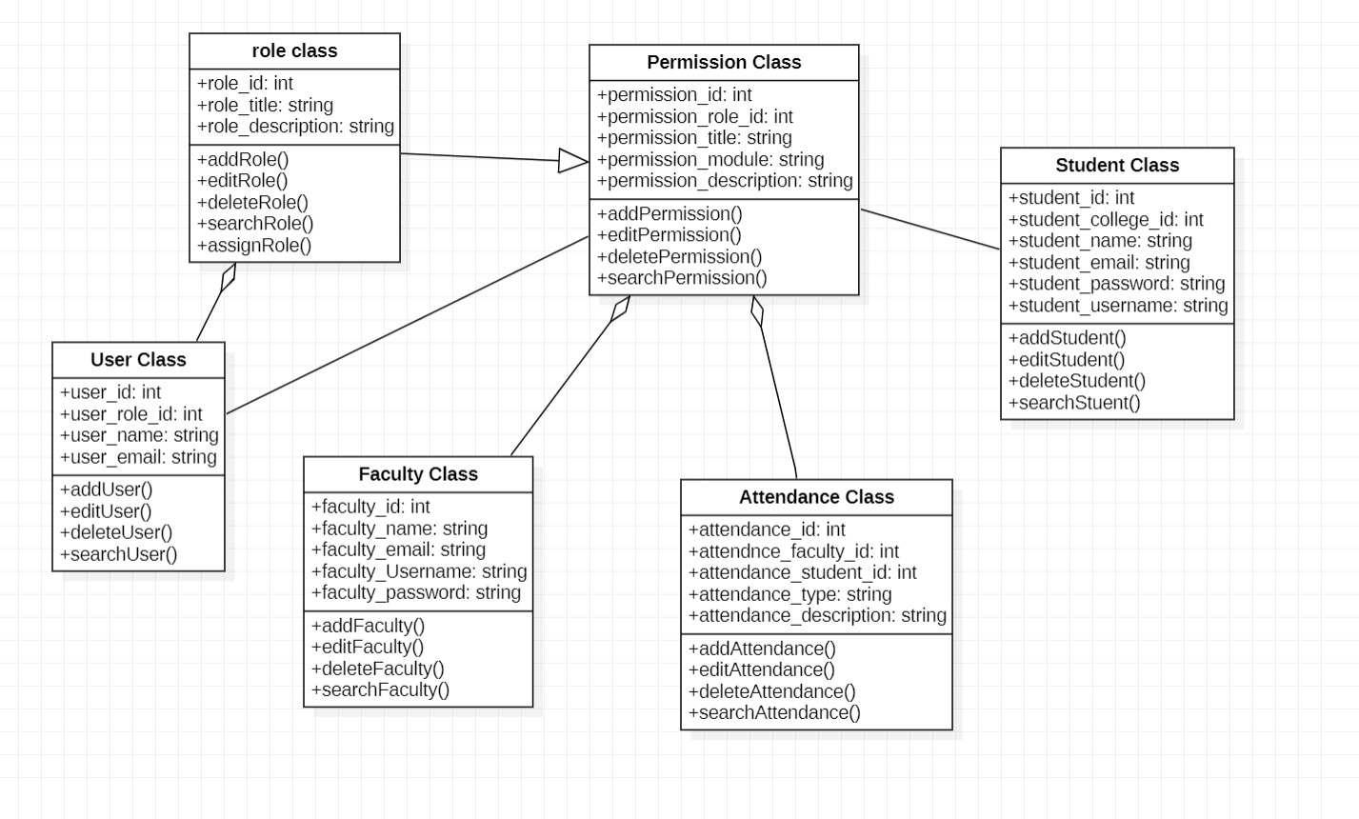
CLASS DIAGRAM:

Slide 52
Entity Relationship Diagram
QR Code Attendance System

Slide 53
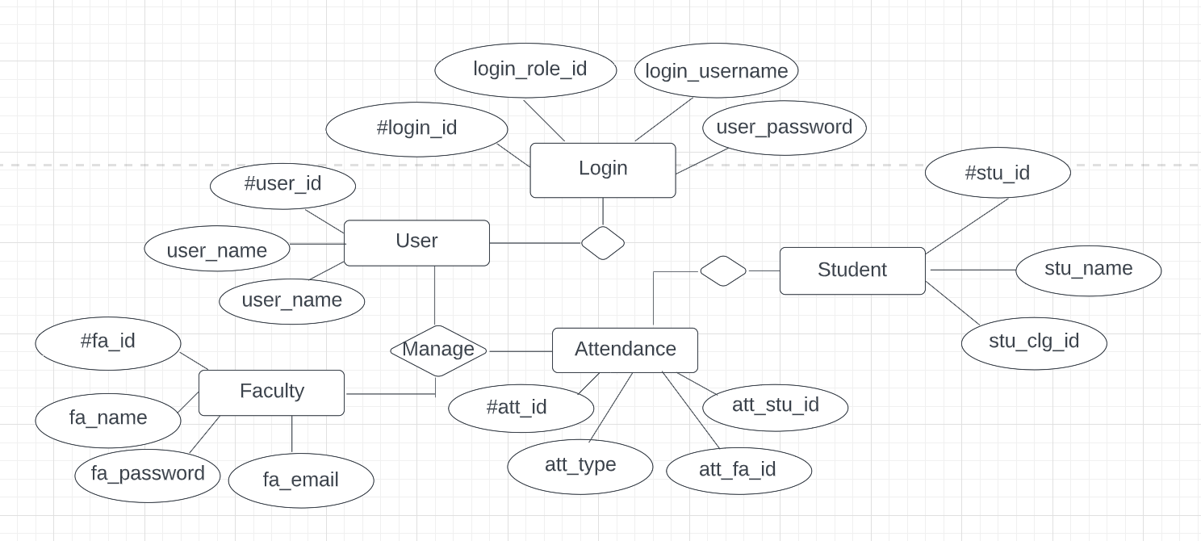
ER Diagram

Slide 54

ER (Entity Relationship) Diagram:
This ER (Entity Relationship) Diagram represents the model of Attendance Management System Entity. The entity-relationship diagram of Attendance Management System shows all the visual instrument of database tables and the relations between Employee, Holidays, Attendance, Login etc. It used structure data and to define the relationships between structured data groups of Attendance Management System functionalities. The main entities of the Attendance Management System are Attendance, Faculty, Student and Login.
Attendance Management System entities and their attributes:
Attendance Entity: Attributes of Attendance are attendance_id, attendance_faculty_id, attendance_student_id, attendance_type.
Faculty Entity: Attributes of Faculty are faculty_id, faculty_name, faculty_email, faculty_password.
Student Entity: Attributes of Student are student_id, student_college_id, student_name, student_email.
Login Entity: Attributes of Login are login_id, login_username, login_role_id, login_password.

Slide 55
Description of Attendance Management System Database
The details of Attendance is store into the Attendance tables respective with all tables.
• Each entity (Login, Student, Faculty, Attendance) contains primary key and unique keys.
• The entity Student, Leave has binded with Attendance, Faculty entities with foreign key.
• There is one-to-one and one-to-many relationships available between Login, Attendance, Students and Faculty.
All the entities Attendance, Student, Login are normalized and reduce duplicacy of records
• We have implemented indexing on each table of Attendance Management System tables for fast query execution.

Slide 56


Slide 57
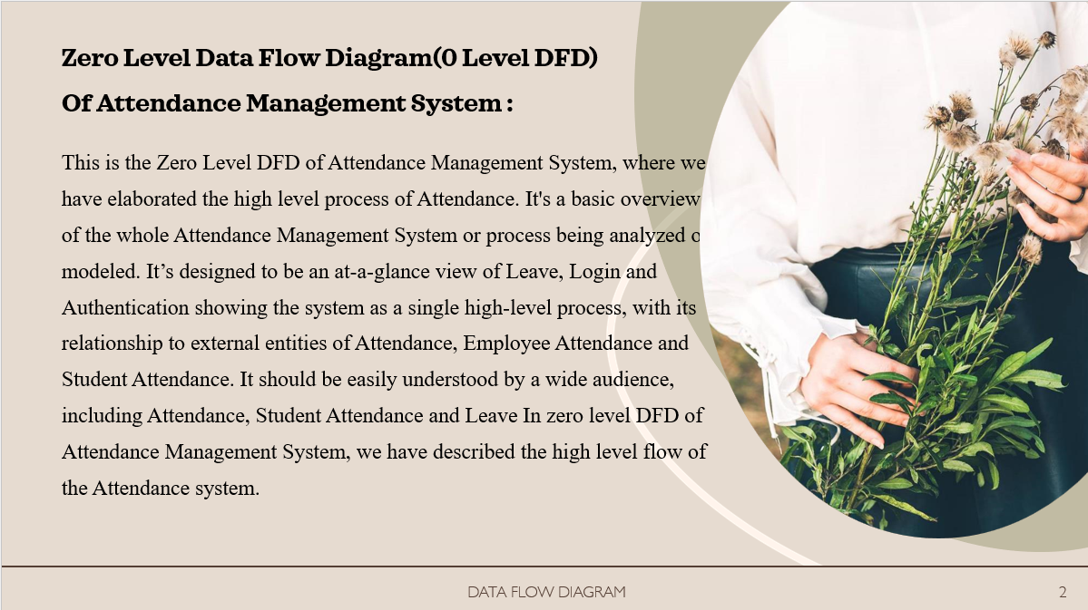

Slide 58


Slide 59
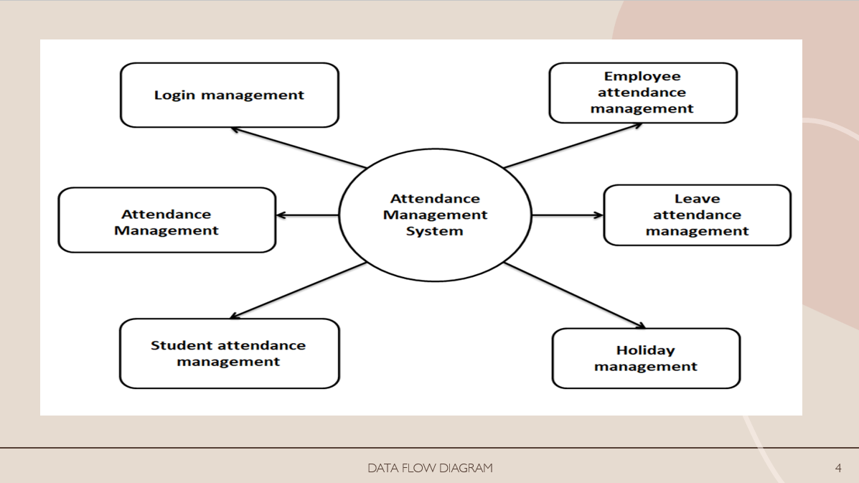

Slide 60
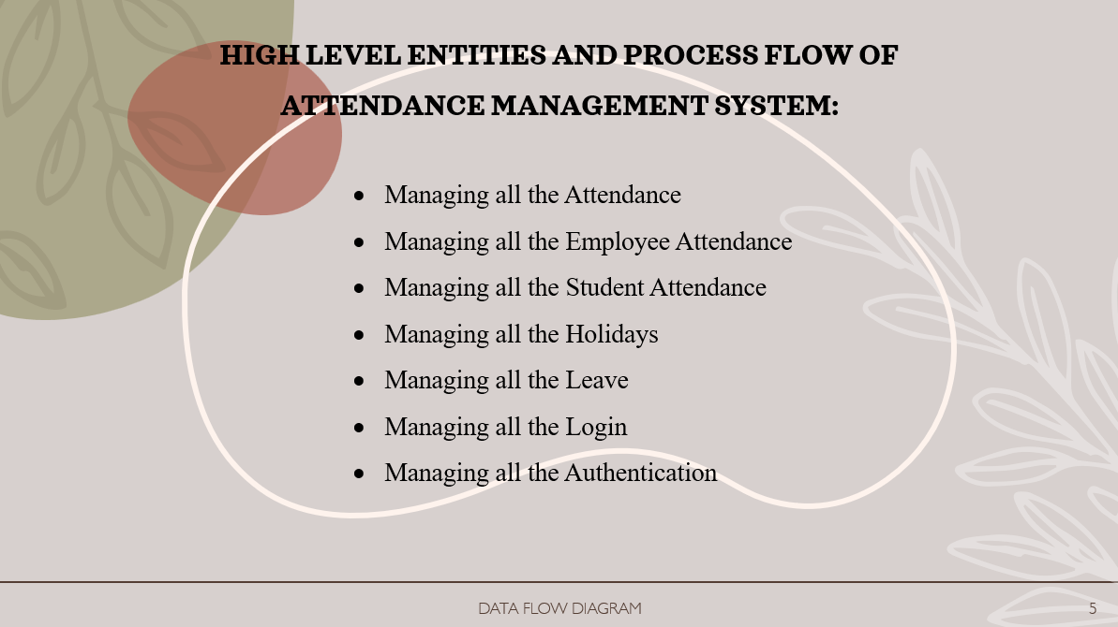

Slide 61
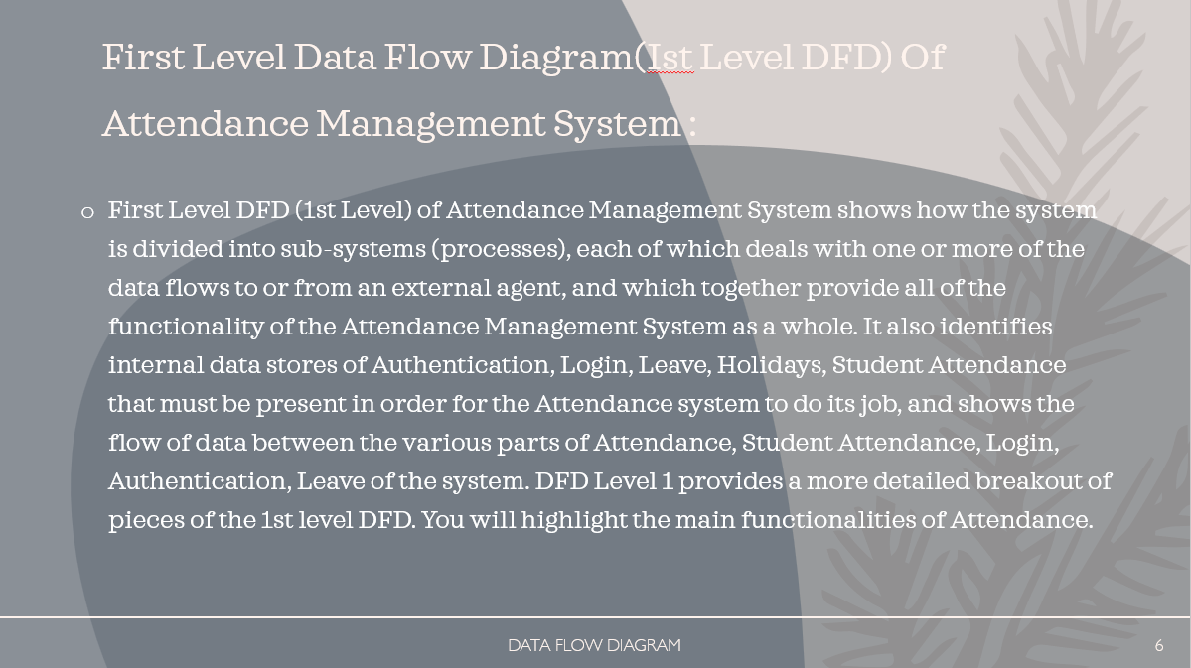

Slide 62
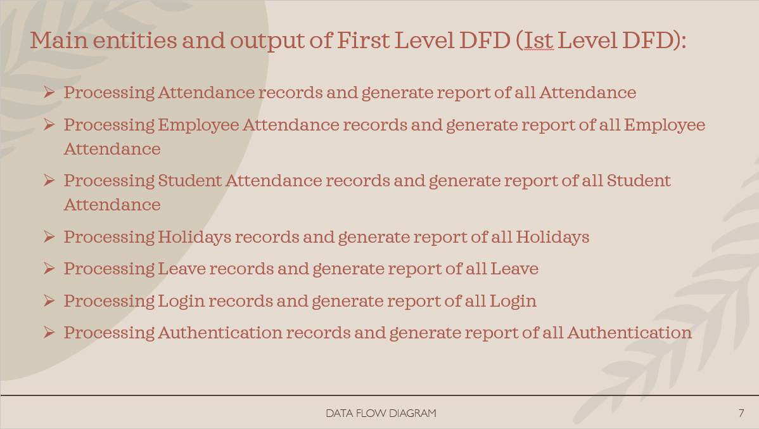

Slide 63
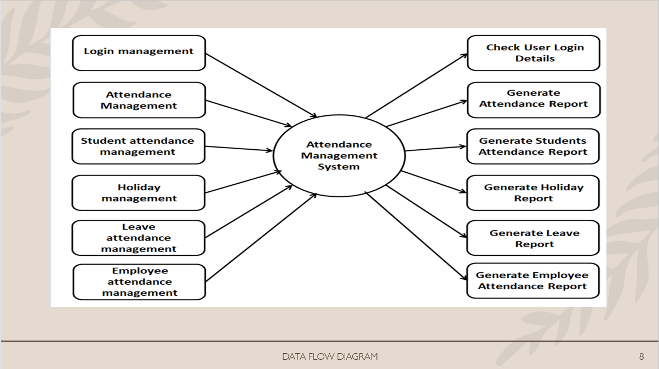

Slide 64

Sequence and Collaboration Diagram
QR code based Attendance System

Slide 65
Sequence Diagram

Slide 66
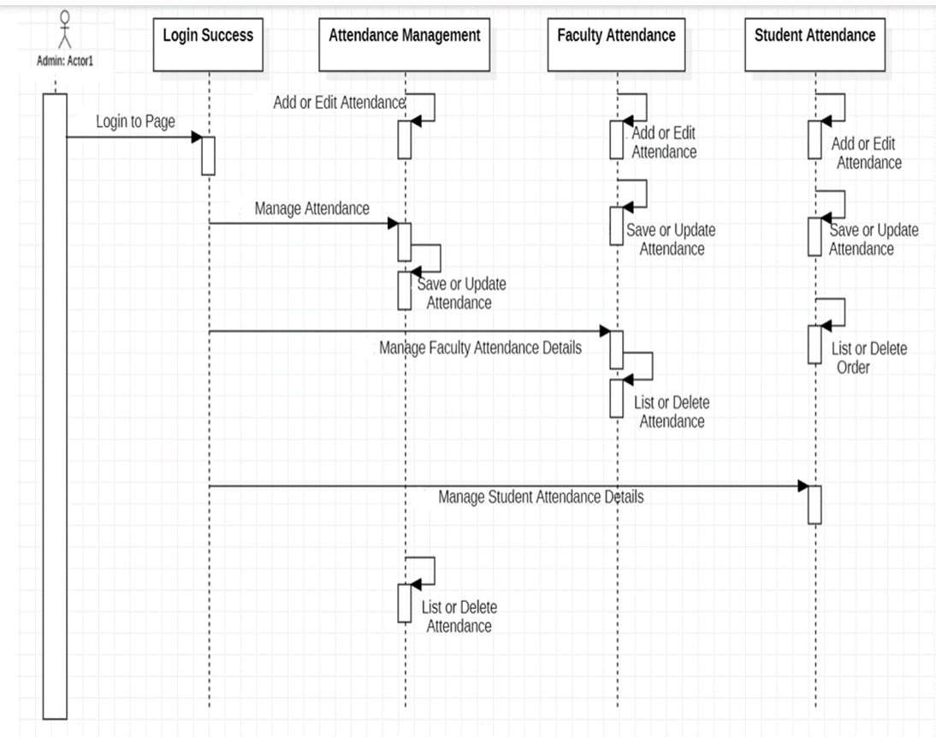

Slide 67
This is the UML sequence diagram of Attendance Management System which shows the interaction between the objects of Login, Attendance, Faculty Attendance, Student Attendance. The instance of class objects involved in this UML Sequence Diagram of Attendance Management System are as follows: • Login Object • Attendance Object • Student Attendance Object • Faculty Attendance Object

Slide 68
Login Sequence Diagram of Attendance Management System:
This is the Login Sequence Diagram of Attendance Management System, where admin will be able to login in their account using their credentials After login user can manage all the operations on Login, Attendance, Student Attendance, Faculty Attendance.
All the pages such as Attendance, Student Attendance, Employee Attendance are secure and user can access these pages after login. The diagram below helps demonstrate how the login page works in the Attendance Management System The various objects in the Student Attendance, Login, Attendance, and Faculty Attendance page interact over the course of the sequence, and user will not be able to access this page without verifying their identity.

Slide 69
Collaboration Diagram

Slide 70
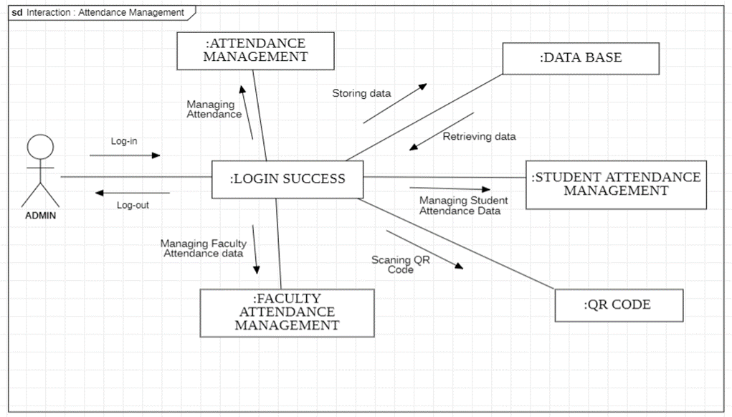

Slide 71
This is the UML Collaboration diagram of Attendance Management System which shows the interaction between the objects of Login, Attendance, Faculty Attendance, Student Attendance, Database and QR code. The instance of class objects involved in this UML Sequence Diagram of Attendance Management System are as follows:
• Login Object
• Attendance Object
• Student Attendance Object
• Faculty Attendance Object
• Data base Object
• QR Code Object

Slide 72
This is the collaboration Diagram of Attendance Management System, where admin will be able to login in their account using their credentials After login user can manage all the operations on Login, Attendance, Student Attendance, Faculty Attendance.
All the pages such as Attendance, Student Attendance, Employee Attendance are secure and user can access these pages after login. The diagram below helps demonstrate how the login page works in the Attendance Management System The various objects in the Student Attendance, Login, Attendance, and Faculty Attendance page interact over the course of the sequence, and user will not be able to access this page without verifying their identity.

Slide 73

Testing Framework/User Interface
QR Code Based Attendance System

Slide 74


Executive Summary
Scope
Objective
Approach
Testing Phases

Slide 75
Executive Summary
Scope:
The scope of testing for the QR code based attendance system is to ensure that the application is functioning as per the business requirements and specifications. The testing should cover functional and non-functional aspects of the application, including but not limited to attendance marking, user authentication, data storage, and system performance.
Objective:
The objective of testing the QR code based attendance system is to identify any defects or issues that may exist in the application and to ensure that the system meets the requirements and expectations of the end-users. The testing should ensure that the application is reliable, secure, and user-friendly, and that it can handle a large volume of users and attendance records.

Slide 76
Approach
The approach to testing the QR code based attendance system should be a structured and systematic one that covers both manual and automated testing. The testing approach should include the following:
Test Planning: Develop a comprehensive test plan that outlines the testing strategy, scope, test objectives, and test cases.
Test Case Development: Develop test cases that cover all aspects of the application, including functional and non-functional requirements.
Test Execution: Execute the test cases and record the results. The testing should include both positive and negative testing scenarios.

Slide 77
Defect Management: Track and manage defects found during the testing phase. The defects should be documented, prioritized, and addressed by the development team.
Test Reporting: Generate test reports that summarize the testing results and provide an overview of the quality of the application.
Continuous Testing: Implement continuous testing to ensure that the application remains stable and performs as expected throughout its lifecycle. t

Slide 78
The testing phases for QR based Attendance system typically include the following:
Unit Testing: Unit testing is the first phase of testing, where individual components of the system are tested in isolation. This is done to ensure that each component is functioning as expected and to identify any defects early in the development cycle.
Integration Testing: In this phase, the individual components of the system are combined and tested together as a whole. This is done to ensure that the components are working together as expected and to identify any defects that may arise due to interactions between the components.

Slide 79
System Testing: System testing involves testing the entire system as a whole, including all the components and their interactions. This is done to ensure that the system meets the functional and non-functional requirements and to identify any defects that may have been missed in the previous testing phases.
User Acceptance Testing: User acceptance testing (UAT) is conducted to ensure that the system meets the user requirements and is easy to use. UAT is typically conducted by end-users or stakeholders who are familiar with the system requirements.
Performance Testing: Performance testing is done to ensure that the system meets the performance requirements, such as response time, throughput, and resource utilization. This is done to ensure that the system can handle the expected workload and can scale to meet future demand.

Slide 80
Security Testing: Security testing is done to ensure that the system is secure and protected from unauthorized access or attacks. This includes testing the system's access controls, encryption, and vulnerability assessments.
Regression Testing: This testing is conducted to ensure that the changes made to the system during the development cycle have not impacted the existing functionality of the system. Overall, these testing phases are conducted in a systematic manner to ensure that QR code based attendance system is thoroughly tested and meets requirements and expectations of stakeholders. In summary, the testing approach for the QR code based attendance system should be comprehensive and cover all aspects of the application. The objective of testing is to ensure that the application is reliable, secure, and user-friendly, and that it meets the requirements and expectations of the end-users.

Slide 81
Testing Approach
The testing approach for a QR code based attendance system app would involve following steps:
Requirement Analysis:
The first step in testing the QR code based attendance system would be to analyze the requirements of the app to ensure that all the features and functionalities are identified and understood.
Test Planning:
After analyzing the requirements, a test plan should be created that
outlines the test objectives, scope, approach, and test schedule. The test plan should also identify the testing tools and techniques that will be used.

Slide 82
Test Design:
In this phase, test cases are designed to validate the functionality and
usability of the app. Test cases should be designed to test all the features of the app, including basic functionality, error handling, performance, and security.
Test Execution:
Once the test cases have been designed, they should be executed to
ensure that the app functions as expected. The test results should be
documented, and defects should be logged in a defect tracking system.

Slide 83
Test Reporting:
After executing the test cases, a test report should be created that
summarizes the results of the testing. The report should include information on the test coverage, test results, and any defects that were found.
Regression Testing:
Regression testing should be performed after any changes or updates are made to the app to ensure that existing functionalities are not impacted and that new functionalities are working as expected.

Slide 84
User Acceptance Testing:
After the testing has been completed, the app should be tested by end-users to ensure that it meets their needs and is easy to use. Overall, the testing approach for a vehicle maintenance system app should be comprehensive, covering all aspects of the app's functionality, performance, usability, security, and integration with other systems. The testing should be conducted in multiple phases and should involve the use of various testing tools and techniques to ensure that the app is thoroughly tested.
Testing Environment:
The testing environment for a QR code based attendance system should be representative of the production environment in which the system will operate. This includes hardware, software, and network configurations that are similar to those in the production environment.

Slide 85
Here are some key components that should be included in the testing environment:
Hardware: The hardware should be similar to the production environment in terms of the type of computers, servers, and mobile devices that will be used by the end-users. This includes ensuring that the hardware has the required processing power, memory, and storage capacity to handle the application.
Software: The software used in the testing environment should be the same as that used in the production environment. This includes the operating system, database management system, web server, and any other software components used by the application.

Slide 86
Network: The network infrastructure used in the testing environment should be similar to the production environment in terms of the network topology, protocols, and bandwidth. This is important to ensure that the application performs well under realistic network conditions.
Test Data: The testing environment should have a representative sample of the data that will be used in the production environment. This includes customer data, transaction data, and any other data that is required to test the functionality of the application.
Test Tools: The testing environment should have all the required testing tools and software installed, including testing frameworks, test automation tools, and debugging tools.

Slide 87
Security: The testing environment should be secured to ensure that the application is protected from unauthorized access or attacks. This includes securing the network, servers, and any other components that are part of the application.
Overall, the testing environment should be well-designed and maintained to ensure that the testing is effective and that the application is thoroughly tested before it is released into the production environment.

Slide 88
Scope of Testing for QR Code Based Attendance System
The scope of testing for the QR code based attendance system includes both functional and non-functional aspects of the application. The testing aims to ensure that the system meets the business requirements and specifications, and that it is reliable, secure, and user-friendly.
Functional Testing:
The functional testing will cover all modules of the application, including user authentication, QR code scanning, attendance marking, and data storage. The testing will include both positive and negative scenarios to ensure that the application works as intended. Automation will cover all critical path test cases, and regression testing will be performed to ensure that any changes to the application do not affect its existing functionality.

Slide 89
Non-Functional Testing:
The non-functional testing will cover all non-functional requirements, including performance, security, usability, and scalability. Performance testing will be conducted to ensure that the application can handle a large volume of users and attendance records. Security testing will be performed to identify and address any vulnerabilities in the system. Usability testing will be conducted to ensure that the application is user-friendly and easy to navigate. Scalability testing will be conducted to ensure that the system can handle an increase in user and attendance volume.
In summary, the scope of testing for the QR code based attendance system includes both functional and non-functional aspects of the application. The testing will cover all modules and non-functional requirements to ensure that the system meets the business requirements and specifications and is reliable, secure, and user-friendly.

Slide 90
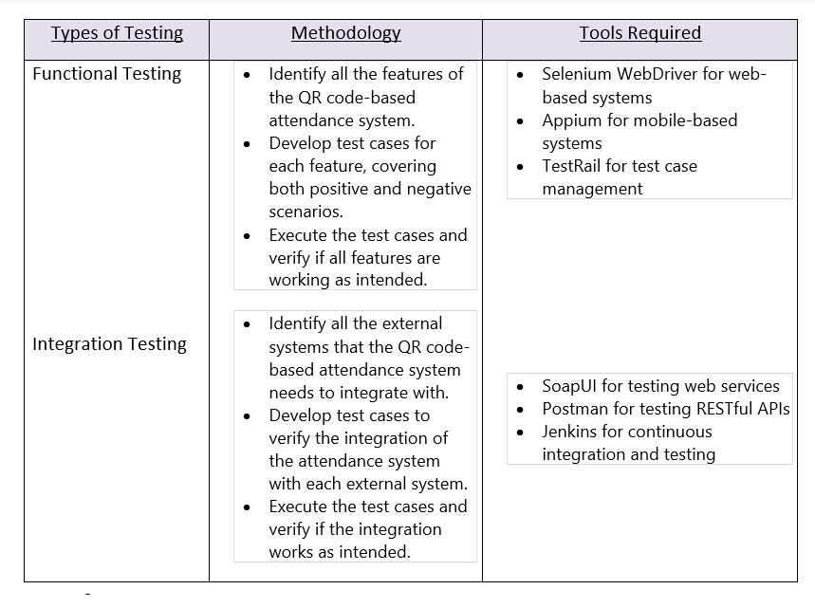

Slide 91
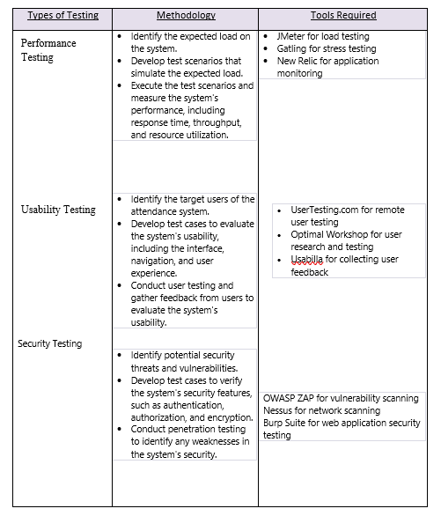

Slide 92
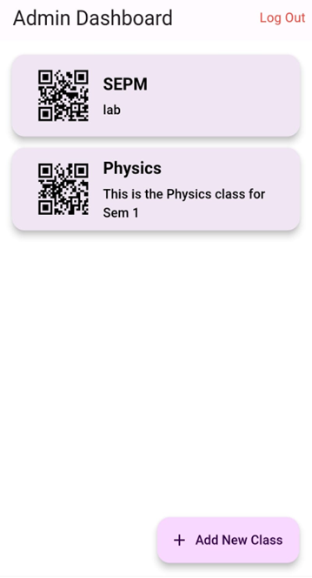
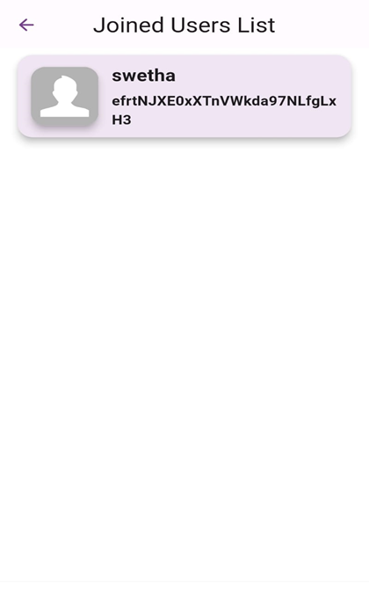
Key Screen Interfaces: Admin’s Screen:

Slide 93
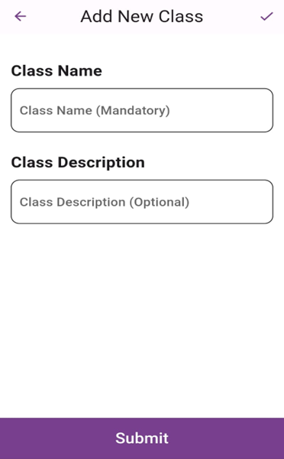
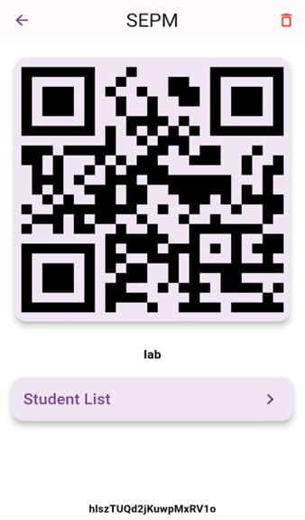

Slide 94
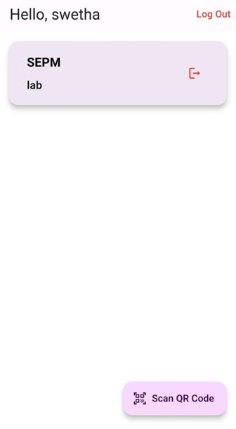
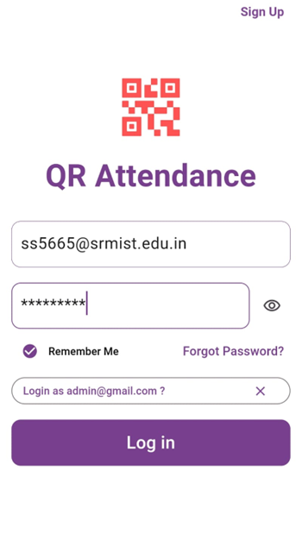
Key Screen Interfaces Student’s Screen:

Slide 95


